Slide 1
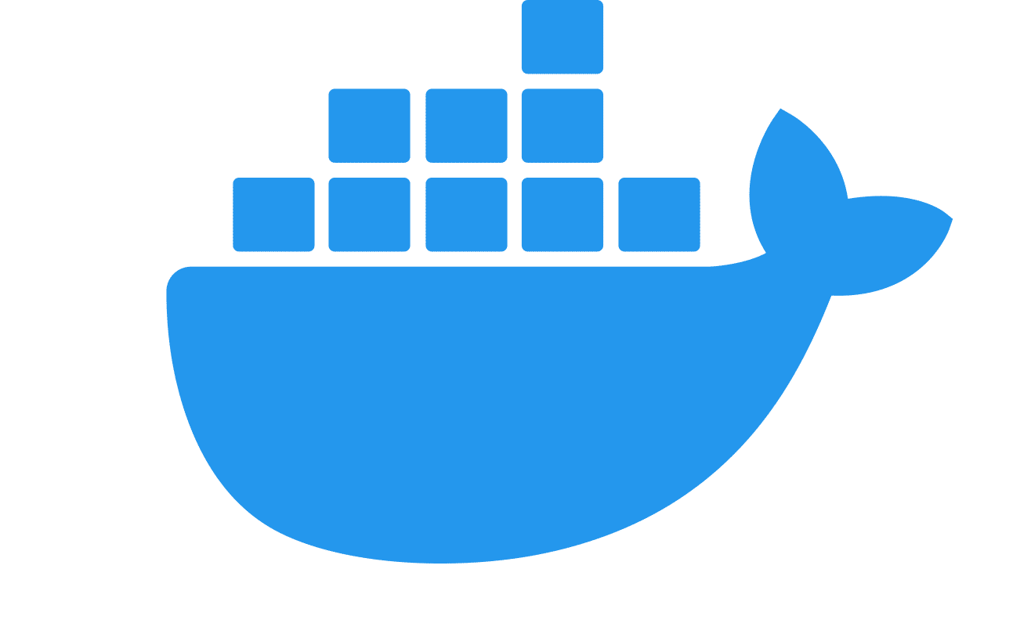
Docker Compose App in the Cloud
Greta Piliponytė, Jana Karas, Jördis Krieger

Slide 2
Contents
Basic Idea and Tools
Our Solution
Working Demo
Possible Improvements

Slide 3
Basic Idea & Tools

Slide 4





Starting Point
Docker-based web application for managing apartments
Consists of several containers
Apartments
docker-compose.yml
Reserve
Search
Notes:
Point out that the containers talk to each other via a Message Queue and that the application is built using docker-compose (Reason (don‘t mention): This is important because that‘s why we didn‘t separate the containers and use the AWS Elastic Container Service or Lambda)

Slide 5
Basic Idea
Create EC2 machine
EC2 machine
Push
Create Infrastructure with Terraform
Deploy app with docker compose

Slide 6

GitHub Actions
Create EC2 machine
EC2 machine
Push
Create Infrastructure with Terraform
Deploy app with docker compose

Slide 7
GitHub Actions
Platform for continuous integration and continuous delivery (CI/CD)
Trigger workflow to deploy our app in the cloud automatically
Trigger
GitHub Action
Print „Hello World“

Slide 8
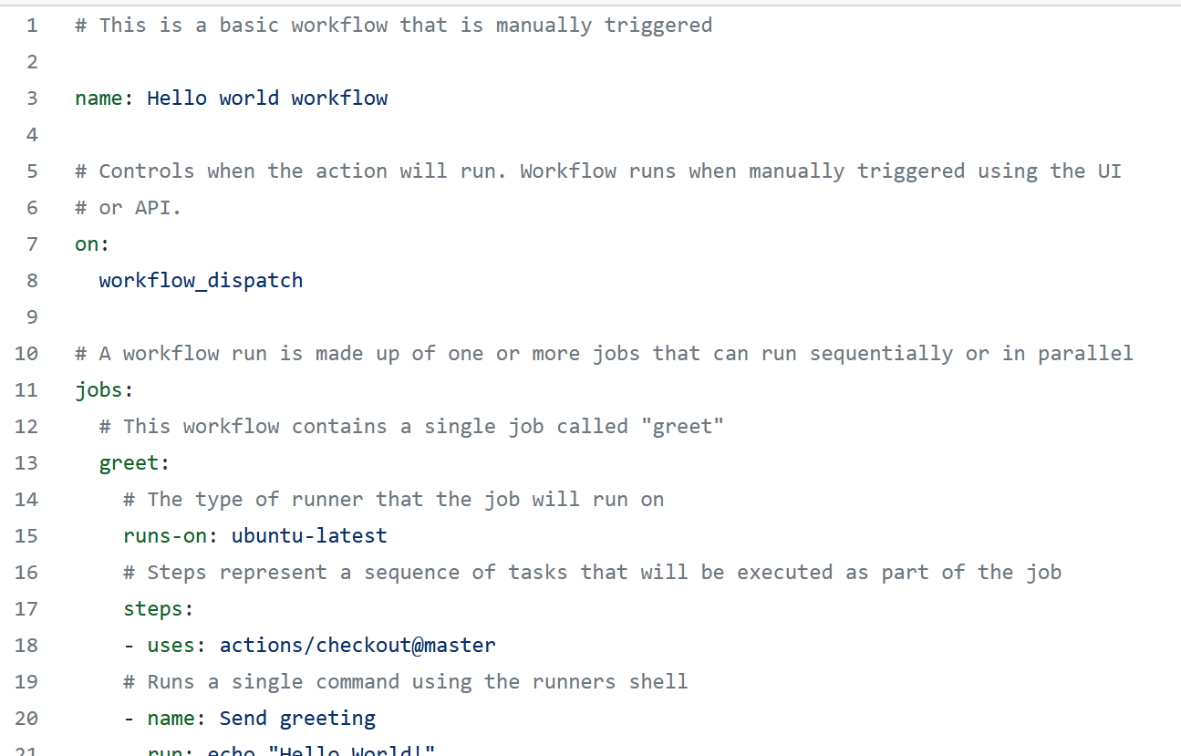
hello_world.yml
Notes:
Just explain how this works following the comments ☺

Slide 9
GitHub Actions
Create EC2 machine
EC2 machine
Push
Create Infrastructure with Terraform
Deploy app with docker compose

Slide 10
Terraform
Create EC2 machine
EC2 machine
Push
Create Infrastructure with Terraform
Deploy app with docker compose

Slide 11
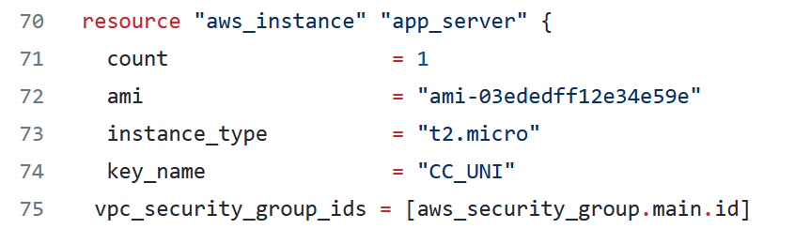
Terraform
Terraform to automatically build, change, and version public cloud infrastructure
Notes:
Show the ami, instance type and security group

Slide 12
AWS
Create EC2 machine
EC2 machine
Push
Create Infrastructure with Terraform
Deploy app with docker compose

Slide 13
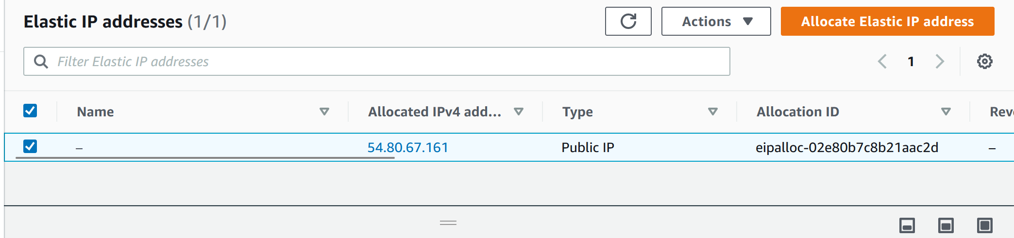
AWS
Amazon Elastic Compute Cloud (EC2) to deploy our application
Security groups
Elastic IP
Notes:
Most interesting thing for the others here is imo the Elastic IP

Slide 14
Solution

Slide 15
Critical Points
Create EC2 machine
EC2 machine
Push
Create Infrastructure with Terraform
Deploy app with docker compose

Slide 16
Critical Points
Create EC2 machine
EC2 machine
Push
Create Infrastructure with Terraform
Deploy app with docker compose

Slide 17
Critical Points
Create EC2 machine
EC2 machine
Push
Create Infrastructure with Terraform
Push docker images to dockerhub
Deploy app with docker compose

Slide 18
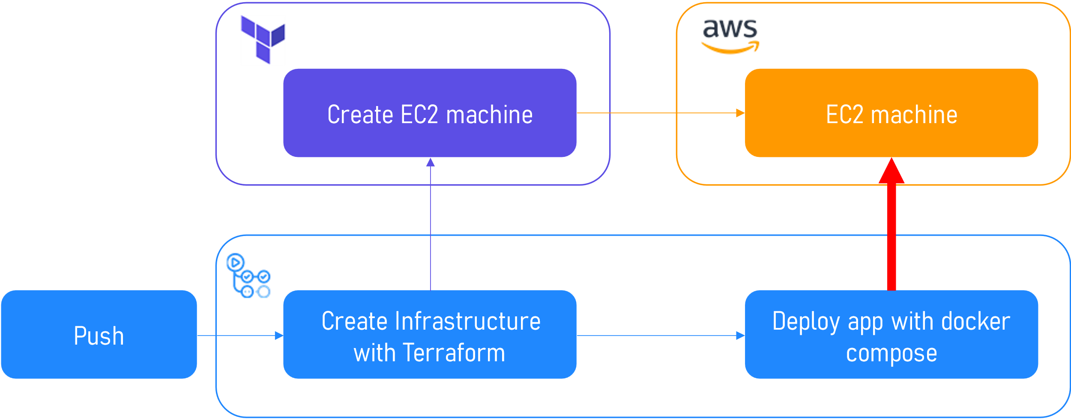
Critical Points
How can we…
…install docker & docker-compose in the EC2?
…put our containers in the EC2?
…start the application via docker-compose up?
Notes:
Critical point is the deployment of the app on the EC2 machine

Slide 19


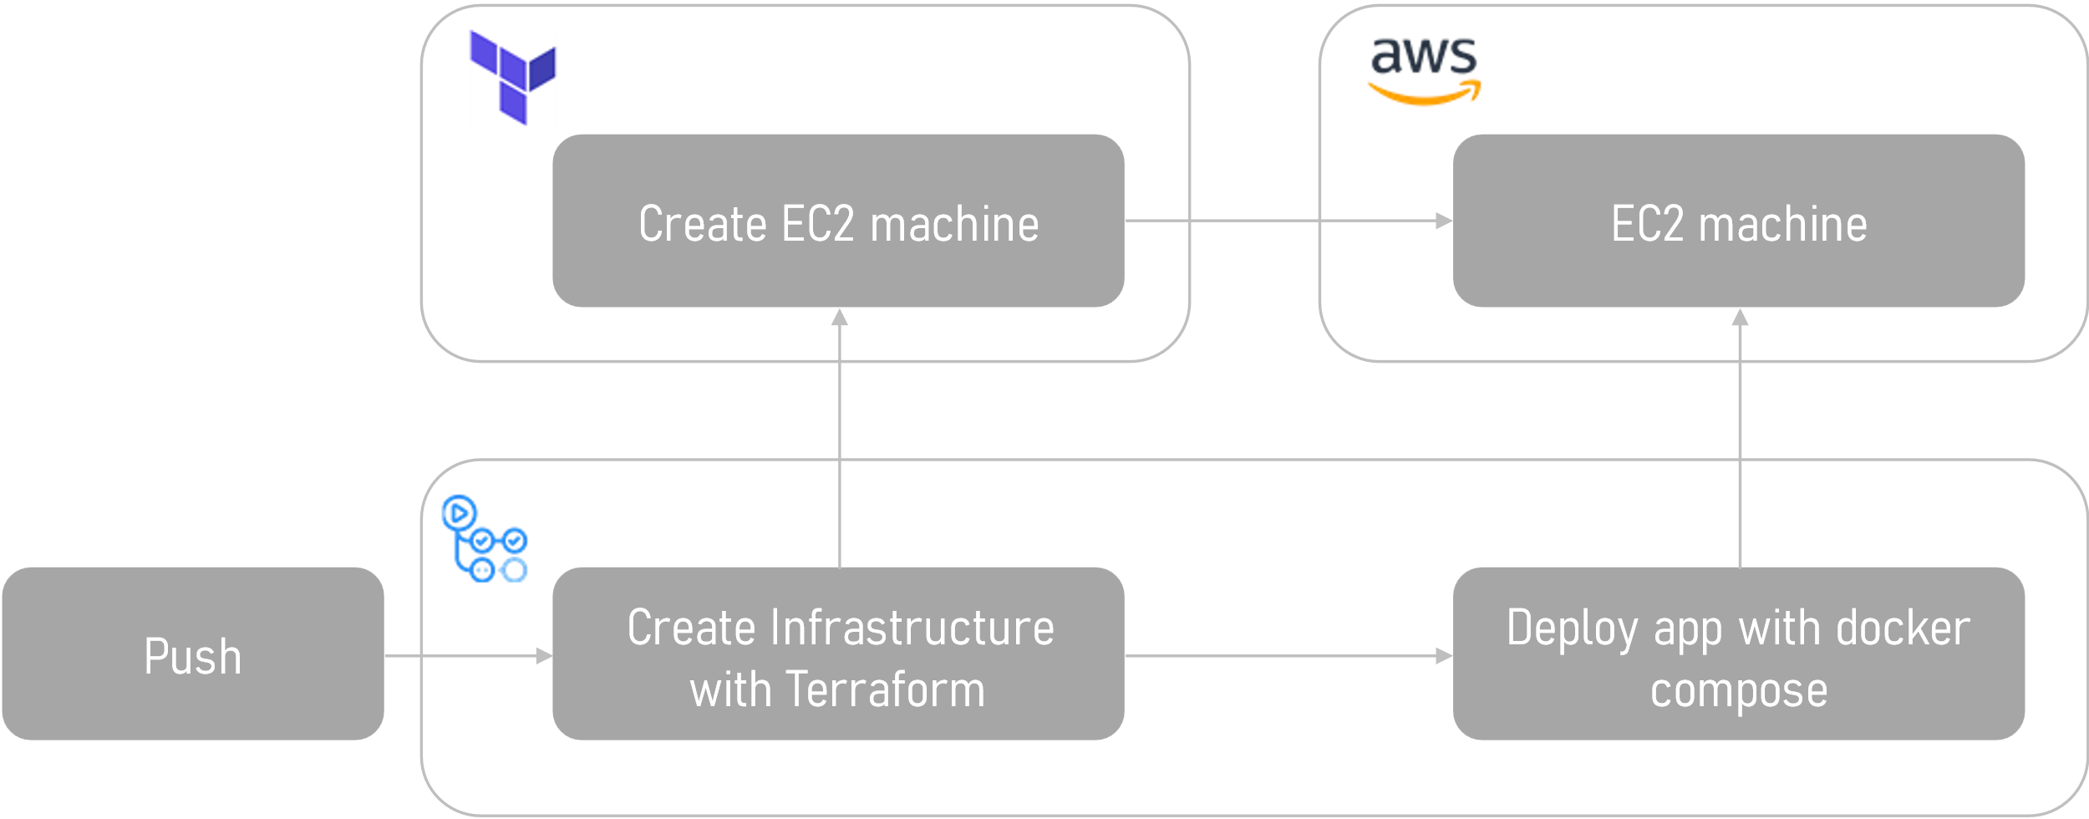

Solution 1
1) Install docker & docker-compose in user_data
3) Upload app via github .zip-Link and docker-compose up
2) SSH into EC2

Slide 20
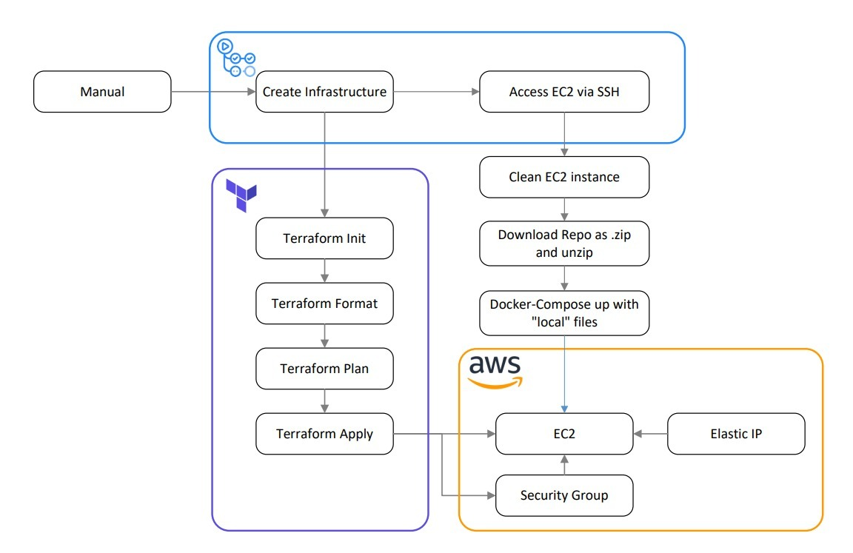

Slide 21
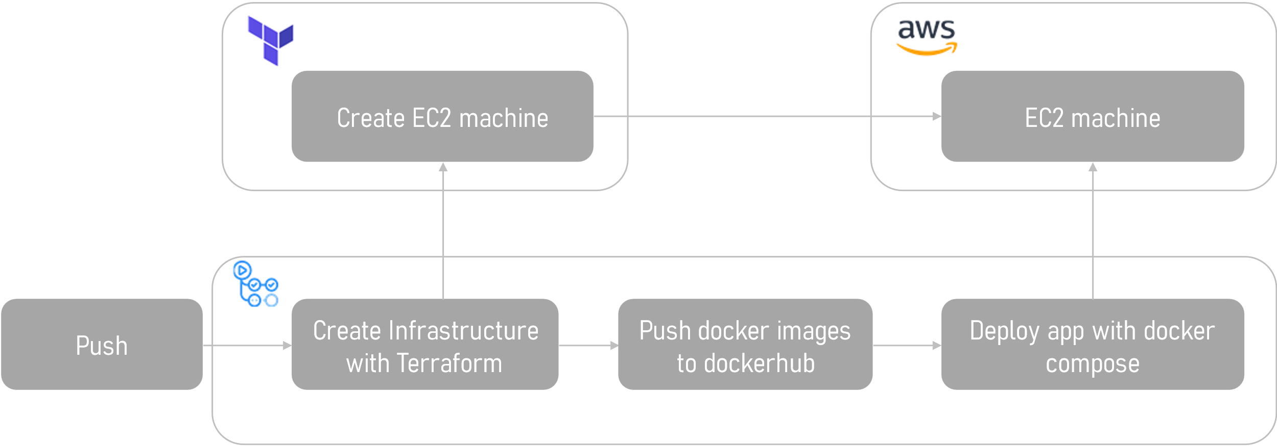
Solution 2
3) Upload composefile and database files with scp, and do docker-compose up with dockerhub-images
1) Install docker & docker-compose in user_data
2) SSH into EC2

Slide 22
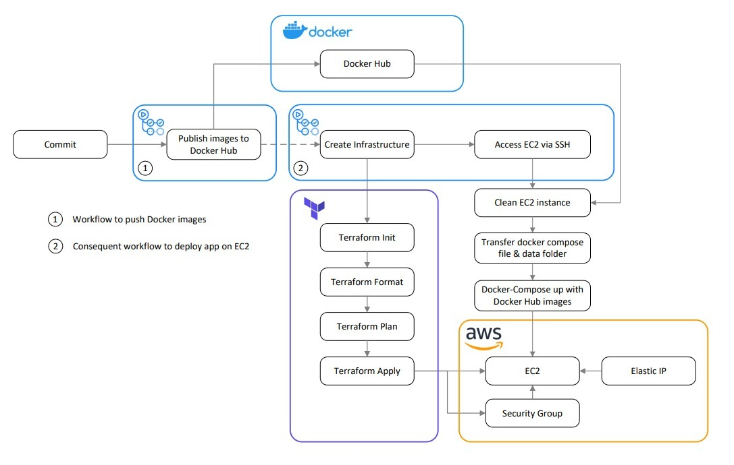

Slide 23
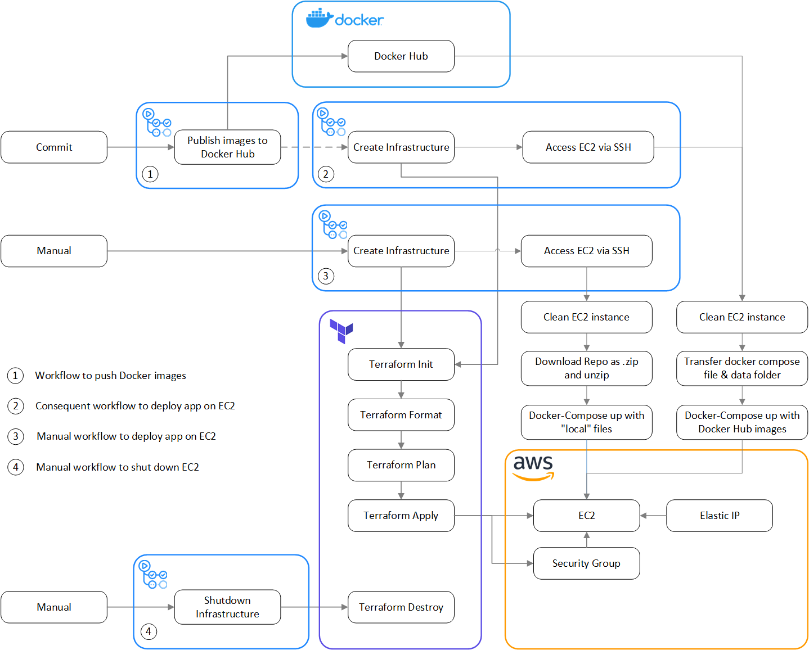
Notes:
Mention here that both workflows use the same EC2 machine and that we also have a workflow for shutting down the EC2

Slide 25
Working Demo
See the magic… 🦄

Slide 26

https://gitlab.inf.unibz.it/Jana.Karas/cloud-computing-project

Slide 27
Challenges & Improvement

Slide 28
Challenges
Terraform State | User_data, SSH and EIP | Security Rules
Use Terraform Remote Backend | User_data for initialization, SSH and EIP for updating | Security Group that opens port 5004

Slide 29
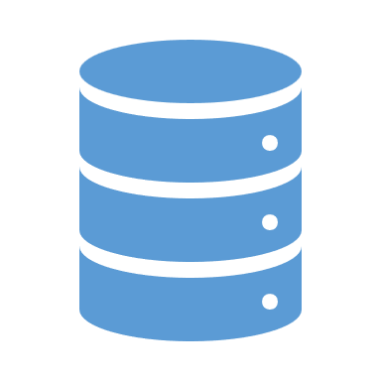
One EC2 instance per container
Current Solution | Problems
 | Lots of virtualization layers can lead to problems Database synchronization is not possible when using Autoscaling Not (easily) possible to use AWS Lambda or Beanstalk
EC2
Container
Container
Container
Build: docker-compose up
Notes:
Like this, the handling of the data would be improved, also it would be possible to implement Autoscaling and Load Balancer, possibility to use an alternative to EC2 (e.g. Lambda, Beanstalk), fewer layers of virtualisation

Slide 30

One EC2 instance per container
Current Solution | Improvement
EC2
EC2
EC2
Container
Container
Container
Container
Container
EC2
Database
Container
Build: docker-compose up
Build and Communication: Find other method
Notes:
Like this, the handling of the data would be improved, also it would be possible to implement Autoscaling and Load Balancer, possibility to use an alternative to EC2 (e.g. Lambda, Beanstalk), fewer layers of virtualisation

Slide 31
Solution 1
Deployment via .zip link:
1) Installation of Docker and Docker Compose SSH to access EC2 instance
Installation of Docker and Docker Compose on EC2
Upload of application via .zip link from GitHub Repo to EC2
Docker-compose up on EC2

Slide 32
Solution 2
Deployment via DockerHub:
1. workflow
Push images to DockerHub
2. workflow:
SSH to access EC2 instance
Installation of Docker and Docker Compose on EC2
Loading of images from DockerHub to EC2
Docker-compose up on EC2 with docker-compose.dockerhub.yml

